Slide 1
Satan, The Devil
Notes:
God, Jesus, Holy Spirit –
Any significant points you recall from the discussion on the Holy Spirit?
Today, we start our study of Satan / The Devil

Slide 2
What comes to mind when you think of
“The Devil”?
Notes:
My first question is what you see on the slide. What do you think about when you hear the phrase “the Devil”?
Appearance, Evil, Liar, Selfish, Hatred, Jealous, Garden of Eden, Sin

Slide 3
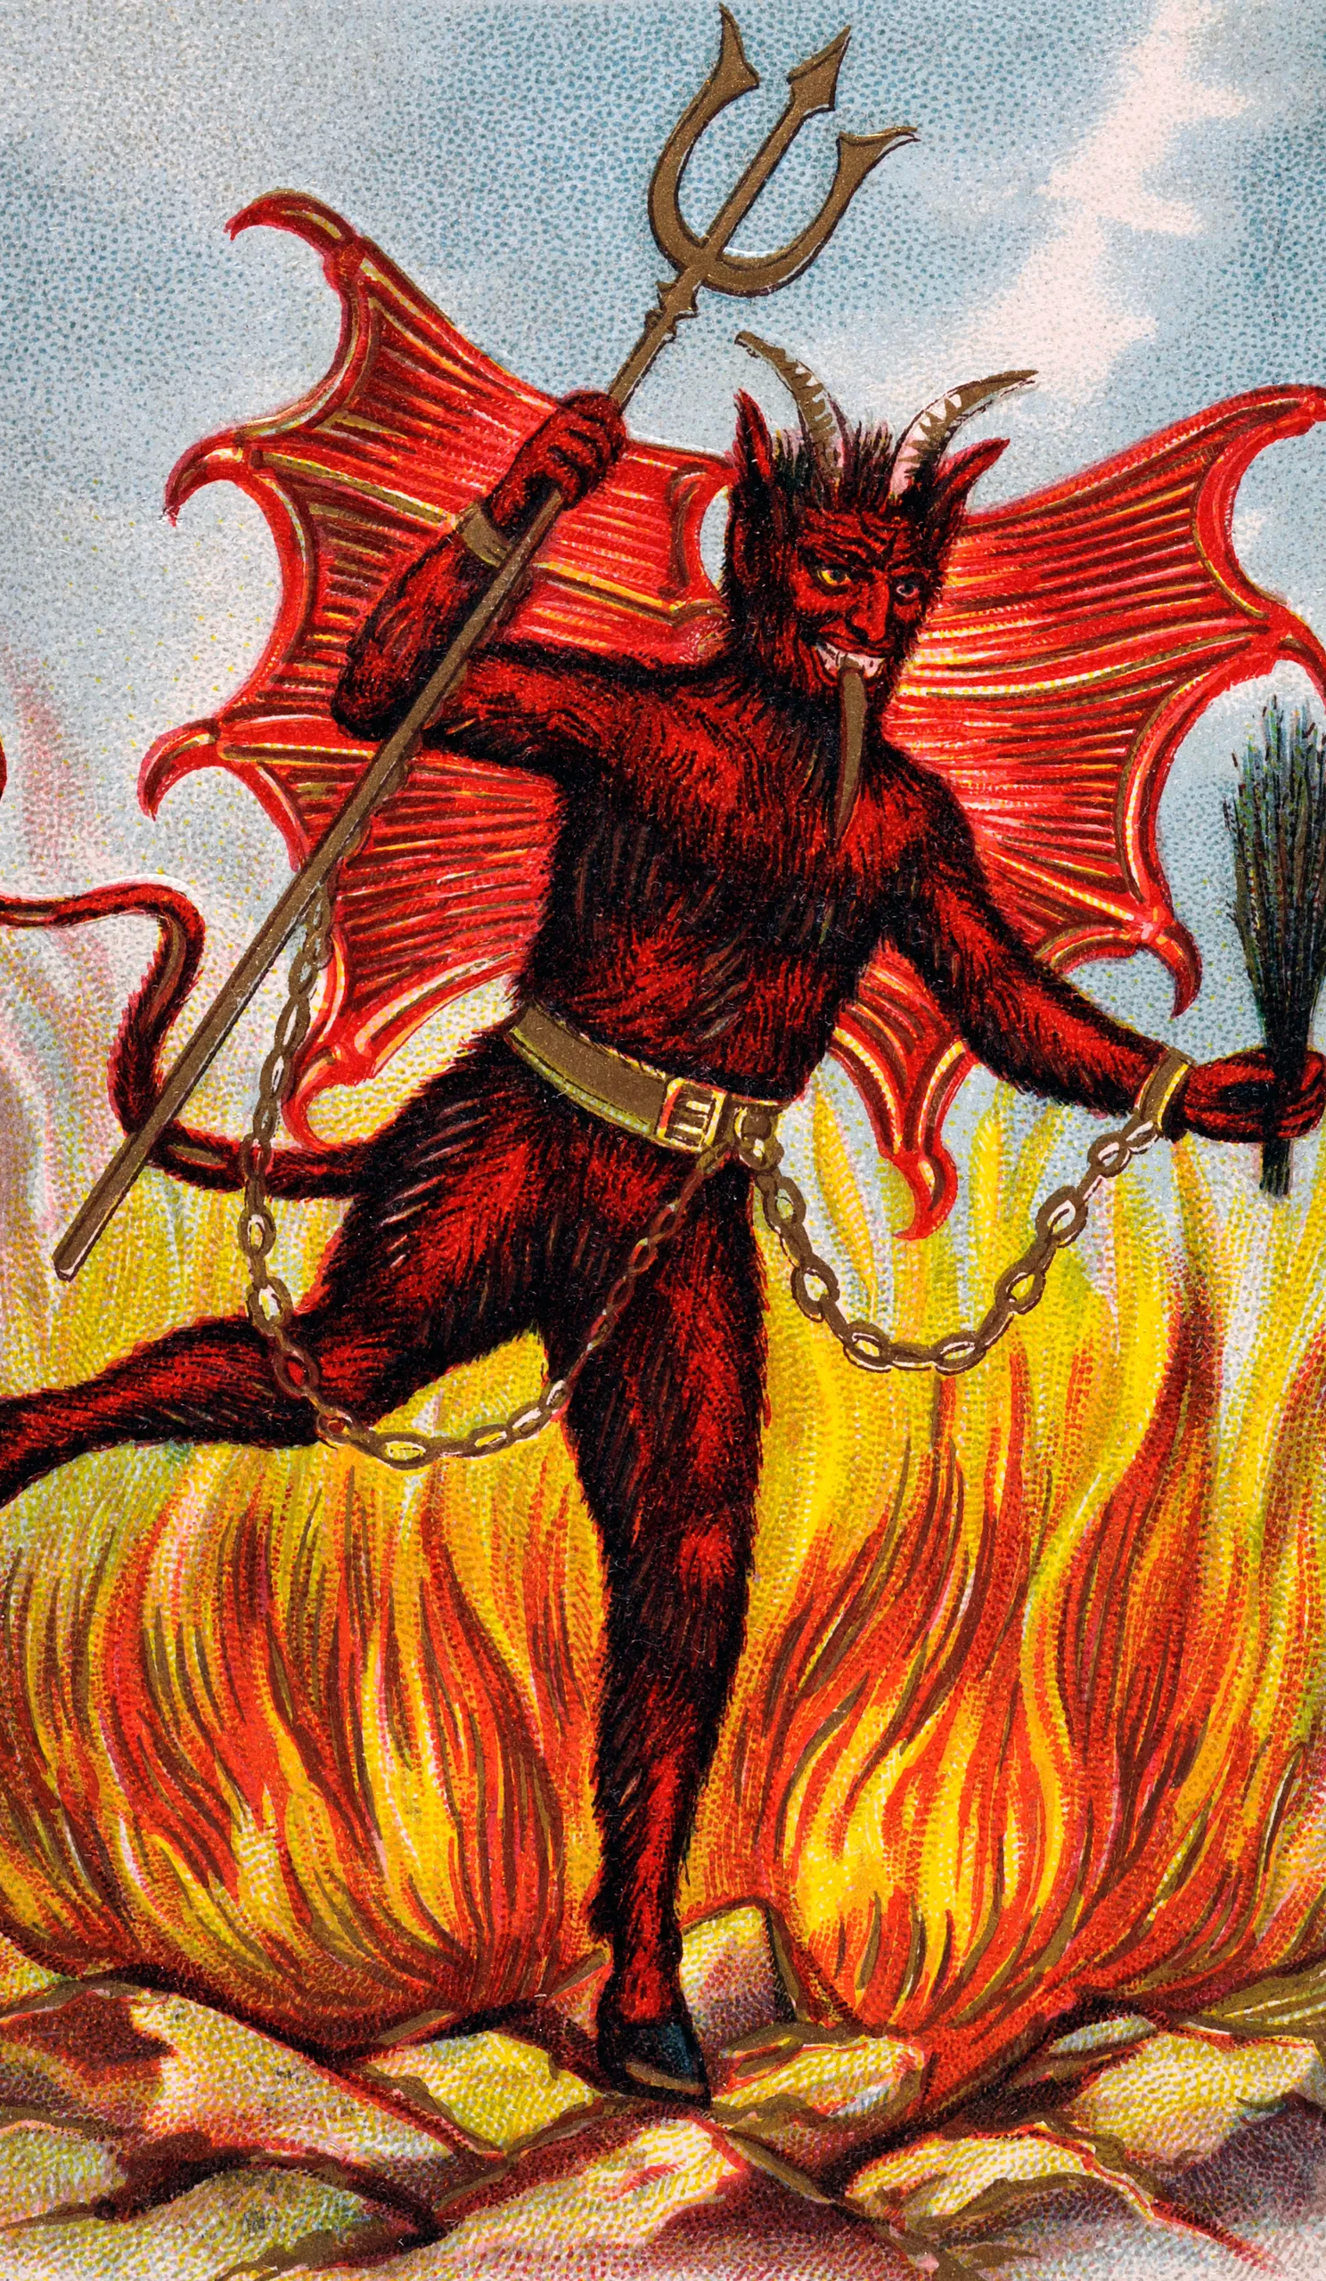
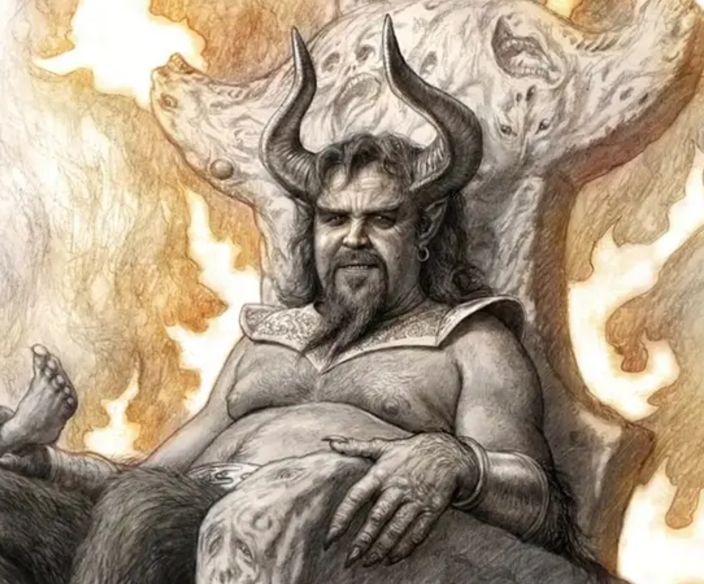
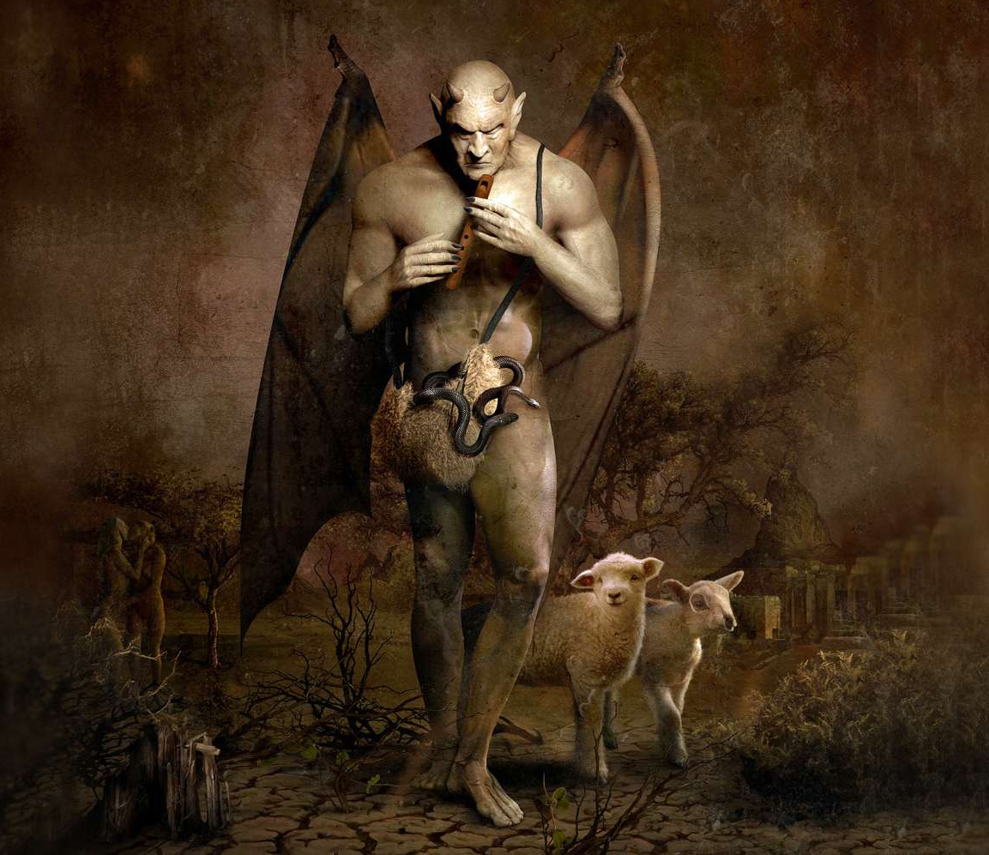
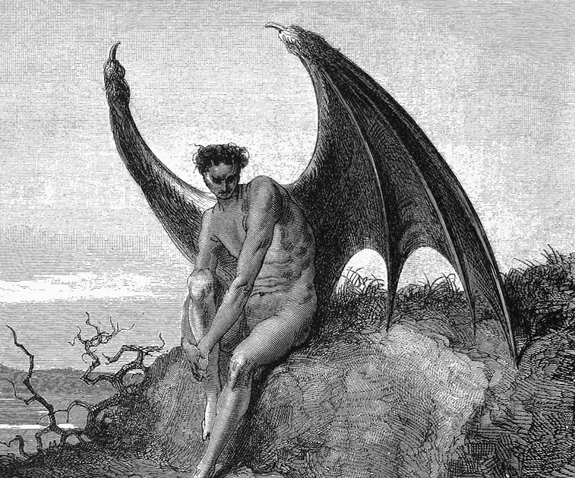
Notes:
Some visualizations of the Devil –
Red, horns, pitchfork, fire, wings,
Man’s depiction of Satan – sometimes comical, sometimes forlorn,

Slide 4
Four out of ten Christians (40%) strongly agreed that Satan “is not a living being but is a symbol of evil.”
Two out of ten Christians (19%) said they “agree somewhat” with that perspective (not a living being).
Only 26% indicated that they believe Satan is a real being.
The remainder were not sure what they believe about the existence of Satan.
Notes:
Is Satan Real?
This is what many “Christians believe”
Satan is not really real. He is just a symbol of evil; or a figment of evil. But he doesn’t really exist.

Slide 5
Biblical Names, Descriptors of Satan
Devil: Mt 4:1
Belial: 2 Cor 6:15 lit: "worthless"
Enemy: Mt 13:39
Serpent: Rev 12:9; 20:2; 2 Cor 11:3
Satan: Mk 1:13
Tempter: 1 Th 3:5; Mt 4:3
Ruler of demons: Mt 12:24
Adversary: 1 Pe 5:8
Strong man: Mt 12:29
Angel of bottomless pit: Rev 9:11
Murderer: Jn 8:44
Great red dragon: Rev 12:3
Liar & father of lies: Jn 8:44
Beelzebub: Mt 12:24
Ruler of world: Jn 12:31; 14:30; 16:11
Accuser of the brethren: Rev 12:10
god of this world: 2 Cor 4:4
The wicked one: Mt 13:19
How do these names make you feel about Satan?
Notes:
Can you recall any names or descriptive terms (adjectives) in the Bible? Quite a few.
Click (Have someone read the names in class)
Click – how do these names make you feel? Quite a bit different from our study of the Jesus who had names like - Savior, Messiah, the Lamb of God, Give of Life, the Holy One.
In our study, we’ll look at some of these aspects of Satan – and we’ll see what the Bible has to say about Him.

Slide 6
Where did Satan come from?
Satan is not self-existent; God is the only eternal self-existent being.
Therefore, Satan must have had an “origin”. He was created.
God created everything that has been created. Jn. 1:3
God created physical beings as well as spiritual beings. Col. 1:15-17
Notes:
First Question about Satan is WHERE DID HE COME FROM? Any ideas?
Click – First point to make is that Satan is not like God. He is not another God. He has not always existed like God.
Click – So Satan must have been created. He had a beginning like the rest of creation. Who have studied that created all things? God through Jesus Christ.
Click – Yes, we learned that in John 1:3 (But isn’t that just talking about the earth and things in it?” Perhaps – but turn to Col. 1:15-17
Click – God created physical and spiritual beings. – What other spiritual beings? Angels, Hosts of Heaven (1 Kings, Psalms) Cherubim, Seraphim, Ministering Spirits,

Slide 7
Did God Create Evil?
Everything God created was Good
“God saw all that he had made, and it was very good.” Gen. 1:31
“Every good and perfect gift is from above, coming down from the Father of the heavenly lights” James 1:17
Kind begets kind: God is good therefore He must have created Satan good.
Notes:
This begs the question then – Did God Create the Evil? And therefore, create the Devil as their leader?
A study of God leads us to know God can only exist with Good. He cannot exist with Evil – It is impossible for God to create evil.
Click – Everything God created was Good!
Click – God created Satan – and can only create Good – therefore, He must have created Satan GOOD.
Thoughts, Comments? This begs a question then doesn’t it? Satan is NOT Good.

Slide 8
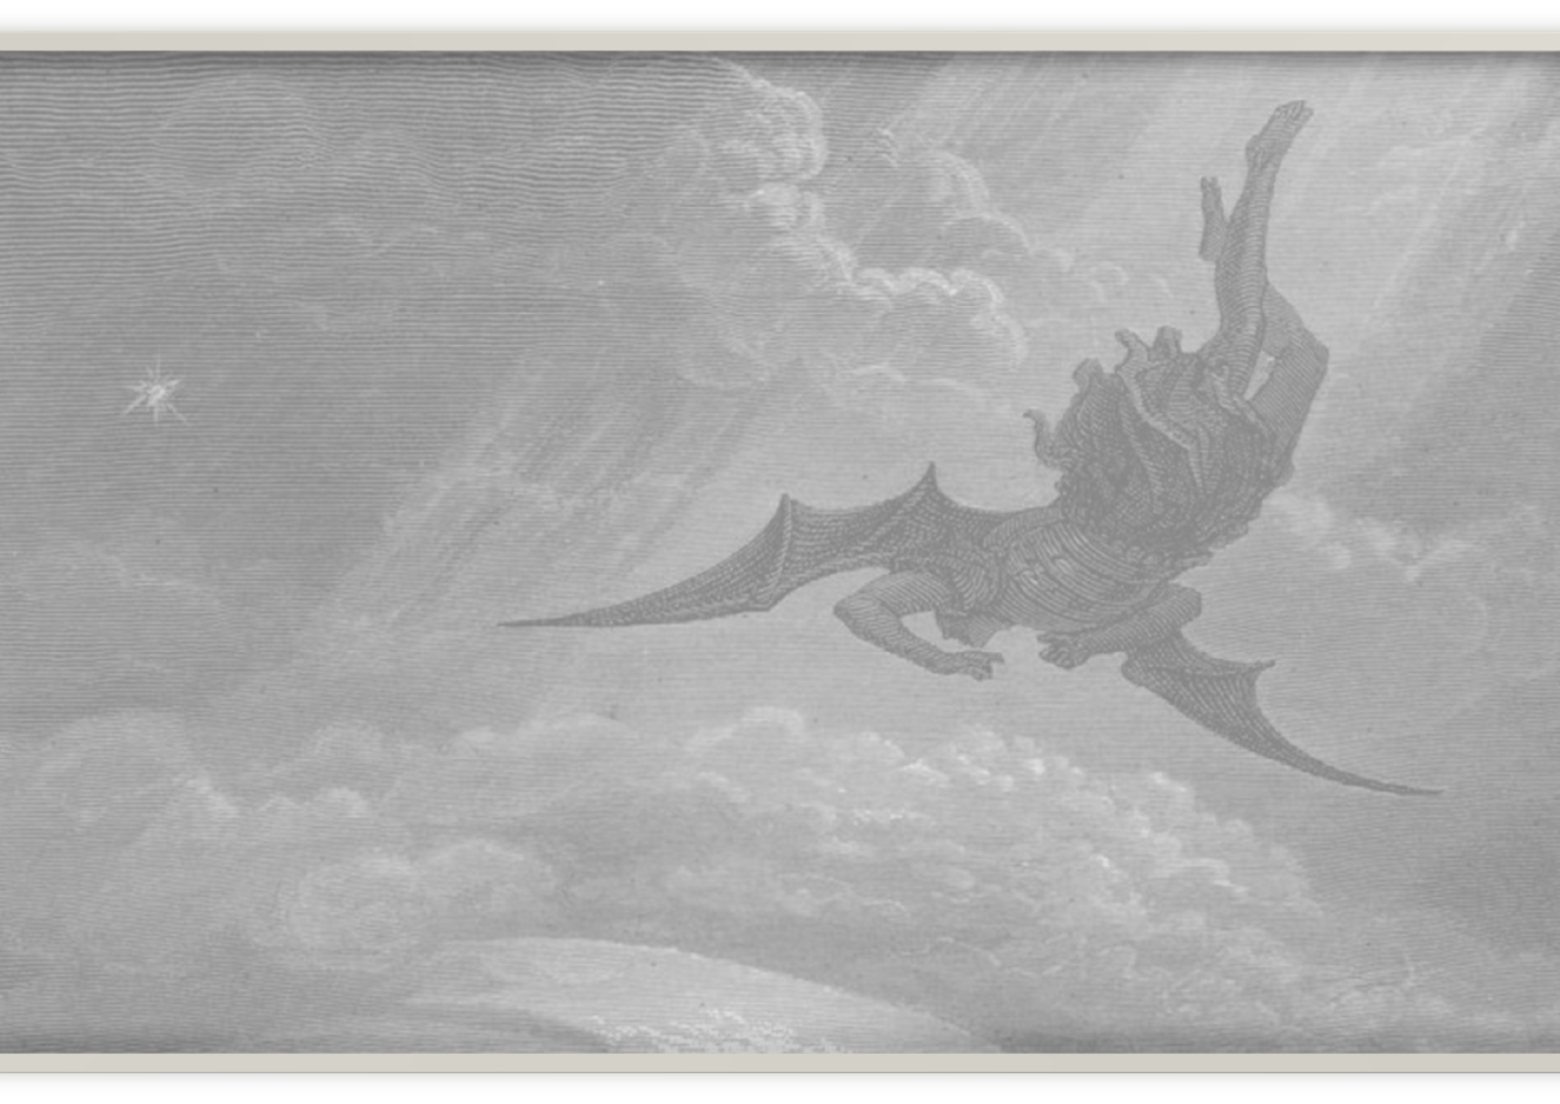
So - What happened?
Was Satan, like Adam, created good and then fell?
Was Satan Cast out of Heaven?
The Bible doesn’t say specifically what happened with Satan.
Notes:
So – what happened?
What have you heard? The Bible doesn’t tell us exactly. There is no “In the Beginning, God created Satan too”
But the Bible does tell us somethings about Satan.

Slide 9
But it does provide some information about Satan
John 8:44 Satan was not truthful
1 Tim. 3:6 Satan fell into condemnation
2 Peter 2:4 Sinful angels were cast into Hades
Jude 1:6-7 Angels deserted their domain
Rev. 12:7-9 Speaks of a war in Heaven; Devil was cast out along with his angels
Notes:
John 8:44 Satan was not truthful
1 Tim. 3:6 Satan fell into condemnation
2 Peter 2:4 Sinful angels were cast into Hades
Jude 1:6-7 Angels deserted their domain
Rev. 12:7-9 Speaks of a war in Heaven; Devil was cast out along with his angels
If angels are cast out of heaven – after falling into condemnation – what does that tell you about the nature of Angels? CHOICE, FREE-WILL.
We have no reason to believe Satan was created any differently. And he could choose to disobey.
REV – figurative language – hard to know how figurative or literal?

Slide 10
Common False Teaching about Satan The Bible indicates that originally Satan was one of the angels God created to serve Him. But Satan became envious of God and decided to rebel against God and try to take His place. His rebellion was unsuccessful, however, and he was thrown out of heaven: “How you have fallen from heaven… You have been cast down to the earth” (Isaiah 14:12).

Slide 11
Common False Teaching about Satan The Bible indicates that originally Satan was one of the angels God created to serve Him. But Satan became envious of God and decided to rebel against God and try to take His place. His rebellion was unsuccessful, however, and he was thrown out of heaven: “How you have fallen from heaven… You have been cast down to the earth” (Isaiah 14:12).
This narrative is derived from two OT passages which do not speak directly about Satan.
Isaiah 14:12-15
Prophecy against King of Babylon
Ezekiel 28:11-19
Lament against the King of Tyre

Slide 12
What do we Know about Satan?
He is the ruler & prince of this world John 12:31; 14:30; 16:11; Eph. 2:2
He is our adversary and actively seeks victims 1 Peter 5:8
He has an army of helpers Eph. 6:12; Matt. 25:41
He has victories in this age Gen. 3:13-14; Luke 22:3; 1 Tim 1:18-20; 1 Tim. 4:1
Notes:
What do we know about Satan?
Let’s read some scripture
He is the ruler & prince of this world John 12:31; 14:30; 16:11; Eph. 2:2
He is our adversary and actively seeks victims1 Peter 5:8
He has an army of helpers Eph. 6:12; Matt. 25:41
He has victories in this age Gen. 3:13-14; Luke 22:3; 1 Tim 1:18-20; 1 Tim. 4:1

Slide 13
Satan vs God
Satan is powerful, but not as powerful as God. 1 John 4:4; John 10:27-29
He was conquered by Jesus via His resurrection Hebrew 2:14; John 12;31
Satan is a defeated foe but remains active until judgment
Notes:
How would you compare Satan against God?
Satan is powerful, but not as powerful as God. His power came from God – the originator.
He was conquered by Jesus via His resurrection Hebrew 2:14
-- Why was this important? To show mankind that God owned eternal life (not Satan) (Garden)
Satan is a defeated foe but remains active until judgment
Basically, Satan is no match for God – maybe more than humans –

Slide 14
Deceives 2 Cor 11:3-4: John 8:44
Disguises Himself 2 Cor. 11:13-15
Blinds Us 2 Cor. 4:3-4
Steals the Word Mark 4:15
Divisions Rom. 16:17-20
Hinders Evangelism 1 Thess. 2:17-18
Our Desires Acts 5:1-3
Tempts 1 Cor. 7:5
Accuses brotherhood Rev. 12:9-10
Causes Grief, Problems
Satan vs. US
Notes:
What are some ways you can think of that Satan works against US/mankind?
Deceives 2 Cor 11:3: John 8:44 (liar – already read)
Disguises Himself 2 Cor. 11:13-15
Blinds Us 2 Cor. 4:3-4
Steals the Word Mark 4:15 parable of sower
Divisions Rom. 16:17-20
Hinders Evangelism 1 Thess. 2:17-18
Our Desires Acts 5:1-3;
Tempts through Lust 1 Cor. 7:5
Accuses brotherhood Rev. 12:9-10
Think a bit more about these and how we respond. Which one do you think is Satan’s most effective ‘modus operandi’?
But Satan is not blatant – he is clever, but powerful.
How does the Bible say he hunts his prey? LIOn

Slide 15
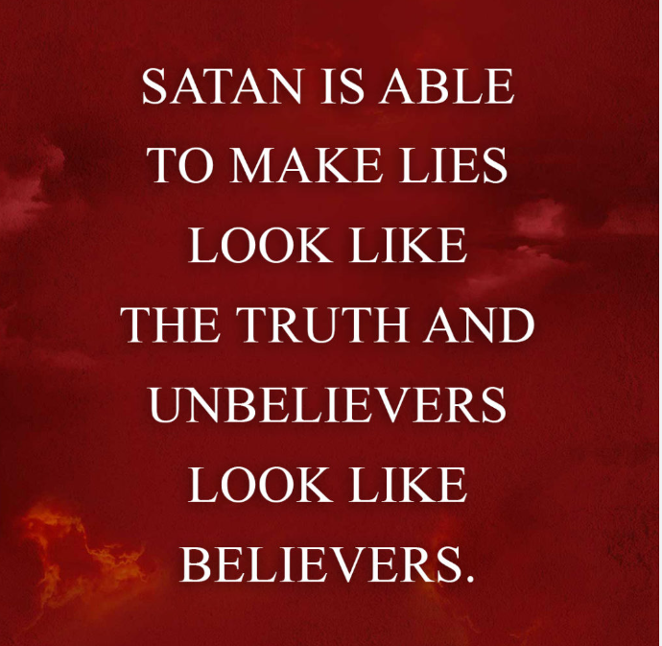
“But I fear, lest somehow, as the serpent deceived Eve by his craftiness, so your minds may be corrupted from the simplicity that is in Christ. For if he who comes preaches another Jesus whom we have not preached, or if you receive a different spirit which you have not received, or a different gospel which you have not accepted—you may well put up with it!”
2 Cor. 11:3-4
Notes:
What do you think is Satan’s main tactic?
Satan’s main tactic is Deceit. He is the father of lies. John 8:44
Calls Evil Good, Good Evil Isaiah 5:20 Woe to those…

Slide 16
“Be sober, be vigilant; because your adversary the devil walks about like a roaring lion, seeking whom he may devour.”
1 Peter 5:8
Notes:
Satan hunts like a Lion. How does a lion hunt?
Silently – camouflaged
Attacks when not-expected, un-prepared
Hunts the weak (not elephants or giraffes)
Devour their prey – finality.
ROARING – after successful.
WHAT CAN WE DO? Prepare – armour up!

Slide 17
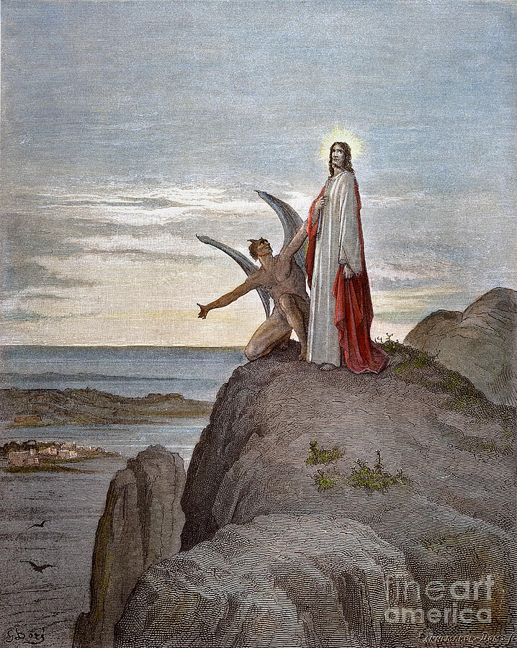
Matthew 4:1-11
Stones to Bread- Satisfy human needs using spiritual gifts
Throw yourself down - Test God
Worship Me – Human Pride/Desire
It is written…
Notes:
Read Mt. 4:1-11
What were the temptations?
How did Jesus Answer?
What is the lesson for us?

Slide 18
"Wherefore take unto you the whole armor of God, that you may be able to withstand in the evil day, and having done all, to stand.
Stand therefore, having on the breastplate of righteousness; and your feet shod with the preparation of the gospel of peace;
Above all, taking the shield of faith, wherewith you shall be able to quench all the fiery darts of the wicked.
And take the helmet of salvation, and the sword of the Spirit, which is the word of God" Ephesians 6:13-17
Notes:
Paul says the same thing!
Use the word of GOD! Ephesians 6:13-17
Armor up! Be prepared!

Slide 19
Yet in all these things we are more than conquerors through Him who loved us. For I am persuaded that neither death nor life, nor angels nor principalities nor powers, nor things present nor things to come, nor height nor depth, nor any other created thing, shall be able to separate us from the love of God which is in Christ Jesus our Lord. Romans 8:37-38
Notes:
We can overcome Satan.
What can separate us from God? NOTHING!!!

Slide 20
Satan will have victories, but will not WIN
1 John 3:8: “The Son of God appeared to destroy the works of the devil.”
Hebrews 2:14: “Christ took on human nature that through death he might destroy him who has the power of death, that is, the devil.”
Colossians 2:15: God “Having disarmed principalities and powers, He made a public spectacle of them, triumphing over them” (at Calvary)
Mark 3:27: “No one can enter a strong man’s house and plunder his goods, unless he first binds the strong man.” (Satan was powerless to stop the coming of the Messiah)
Revelation 20:10 says one day the warfare will be over: “The devil . . . [will be] thrown into the lake of fire and brimstone . . . and will be tormented day and night forever and ever.” Matt. 8:29; 25:41
Notes:
Read from the Slide -

Slide 21
CONCLUSION
There is much about Satan that we do not know. But what we have clearly revealed in Scripture is what God wants us to know.
We have a powerful adversary who is at war against our Lord and his followers. But that adversary is no match for Christ and is a defeated enemy.
If we will be faithful to our Lord, we have nothing to fear from Satan. So, take your stand against him and you will emerge victorious from the battle (Eph. 6:10-17).

Slide 22
Thought Question: Why hasn’t God just Killed Satan?

